Slide 1


Enhancing Agricultural Productivity Using Reinforcement Learning
Group Members:
Amna Ramzan (Reg # 77217)
Laiba Tariq (Reg # 77220)
Syeda Laiba Rehman (Reg # 77238)
Supervisor:
Mr. M Shahid Khan
Computer Science Department

Slide 2










Work Flow Diagram
Project Diagram
UI Screens

Slide 3

INTRODUCTION
🌾 Pakistan lacks accurate crop-yield prediction tools
📉 Farmers struggle with data-driven field decisions
🤖 Proposed: Hybrid Reinforcement–Supervised Learning (HRSL)
📊 Supervised ML → Predicts yield from historical data
🛰️ RL + CNN → Uses satellite images for optimized decisions
🚀 Improves yield forecasting, resources, and profitability

Slide 4



BACKGROUND
TRADITIONAL FARMING ISSUES
Experience-based decisions
No Satellite insights
Low prediction accuracy
MODERN AI BENEFITS
ML improves forecasting
CNN reads satellite images
RL optimizes decisions

Slide 5
PROBLEM STATEMENT
Problem:
Farmers rely on experience-based decisions
Lack of accurate yield prediction
No integration of satellite imagery
Inefficient use of fertilizers, water, and resources
Solution:
Build an accurate ML-based crop yield prediction model
Integrate Reinforcement Learning + agronomic rules for phase-wise optimization
Use satellite imagery + CNN for data-driven field insights
Provide resource recommendations per crop stage
Include cost–benefit optimization for practical profitability
Design a scalable HRSL system tailored to Pakistan’s agriculture sector

Slide 6



SCOPE OF PROJECT
SUPERVISED LEARNING
3029 records
LightGBM best model
High accuracy
REINFORCEMENT LEARNING
2,000+ satellite images
PPO + CNN
Phase-wise decisions
FINANCIAL
MODELING
Pakistan specific costs
Profitability Calculation
Sustainable decisions

Slide 7
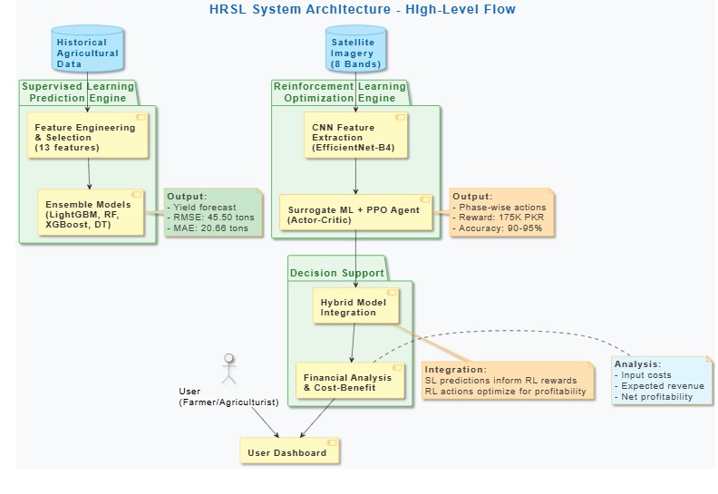
METHODOLOGY / FRAMEWORK

Slide 8
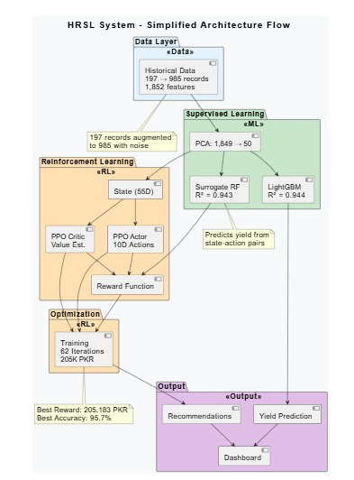
PROJECT DIAGRAM

Slide 9
WORKFLOW DIAGRAM

Slide 10
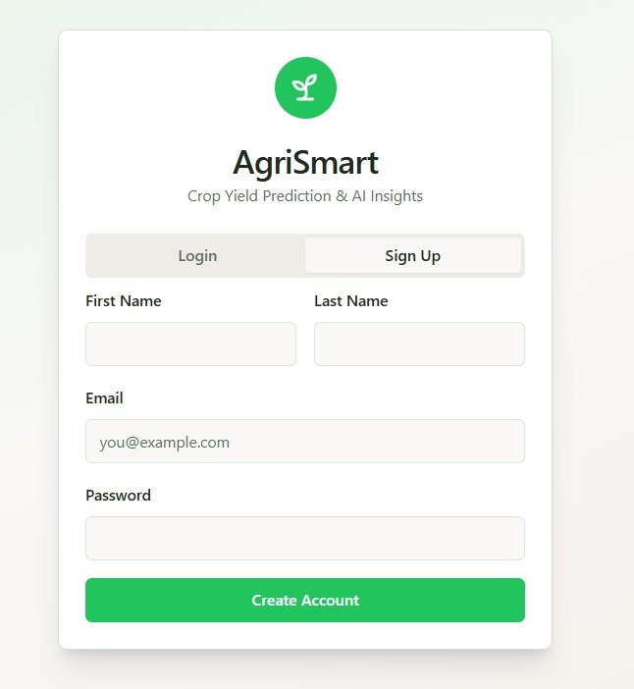
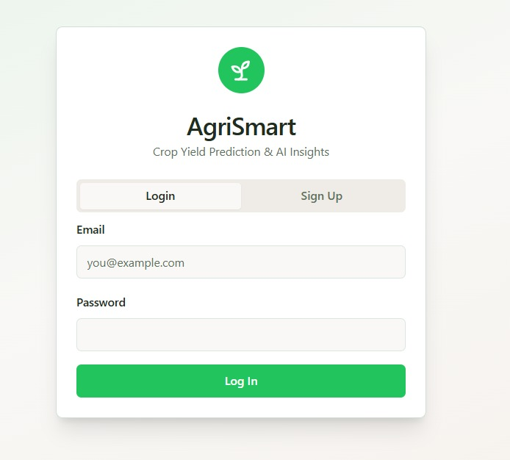
UI SCREENS
Signup Page
Login Page

Slide 11
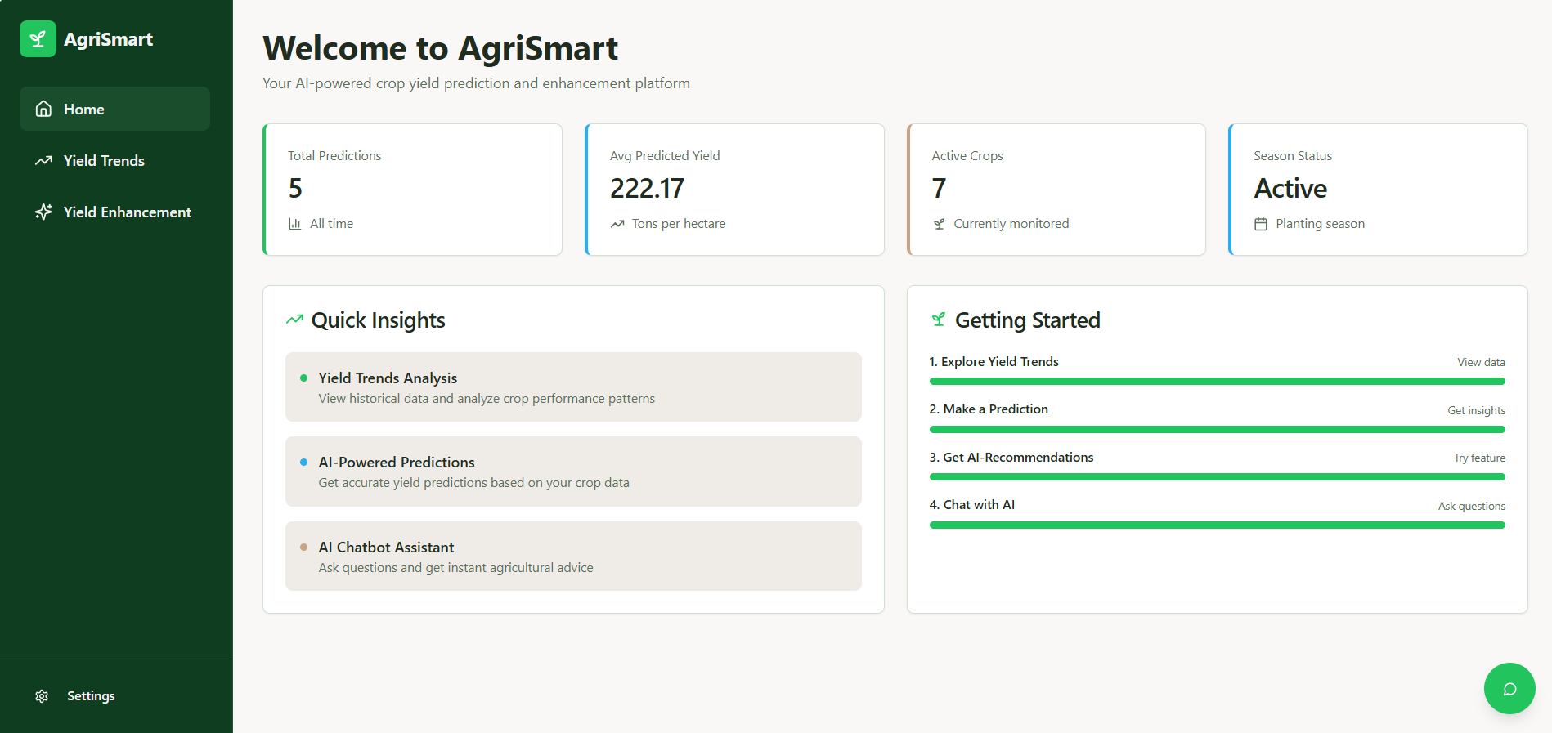
UI SCREENS
Home Page

Slide 12
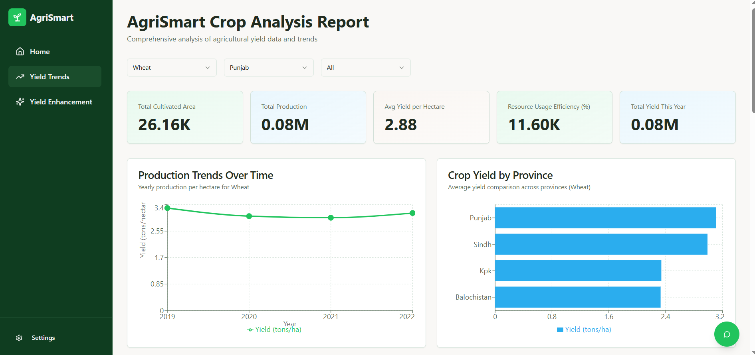
UI SCREENS
Yield Trends Page

Slide 13
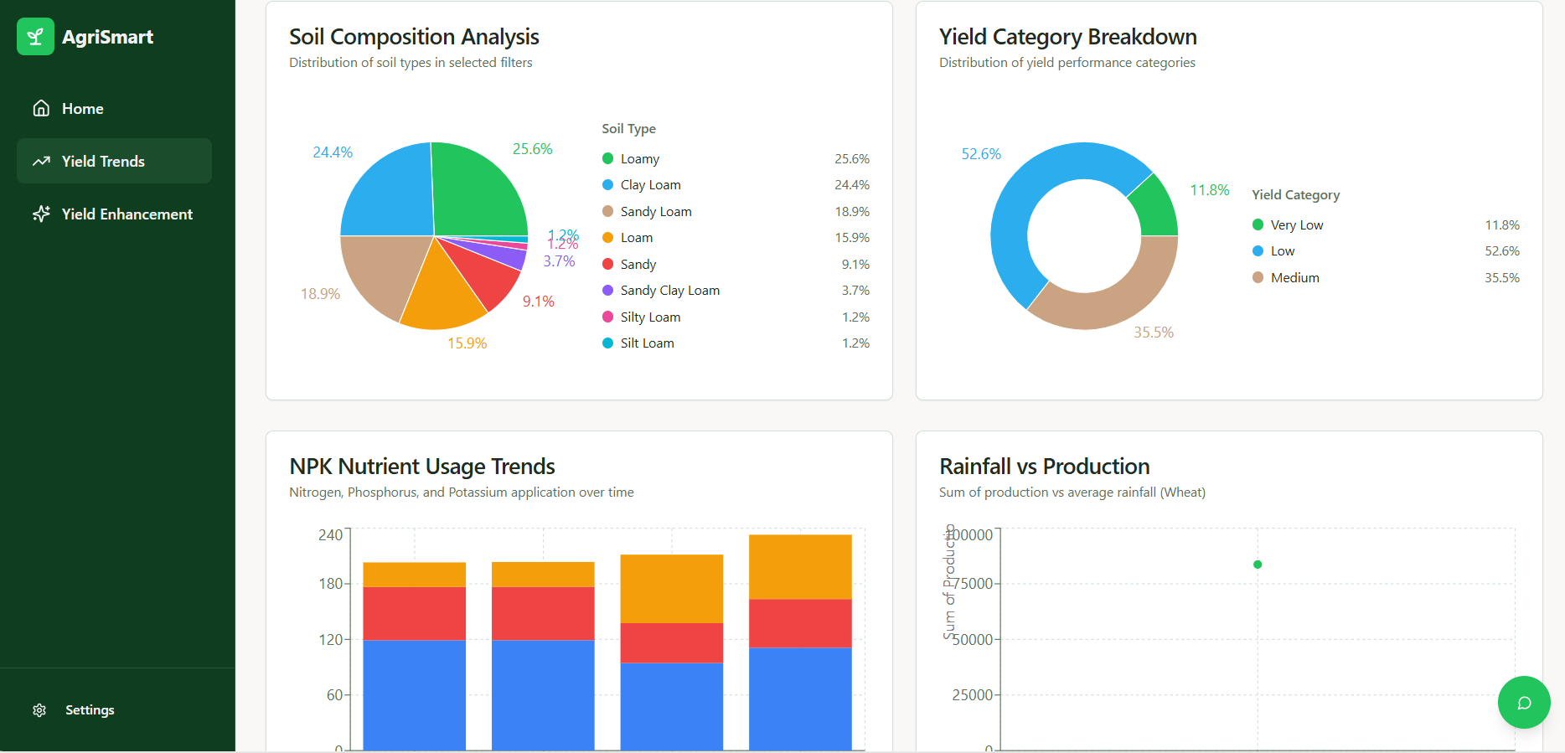
UI SCREENS
Yield Trends Page

Slide 14
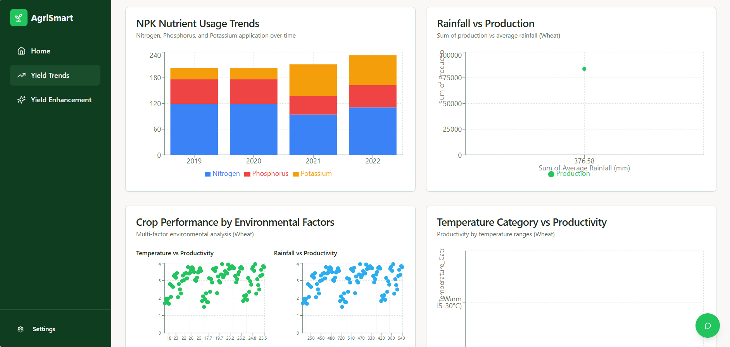
UI SCREENS
Yield Trends Page

Slide 15
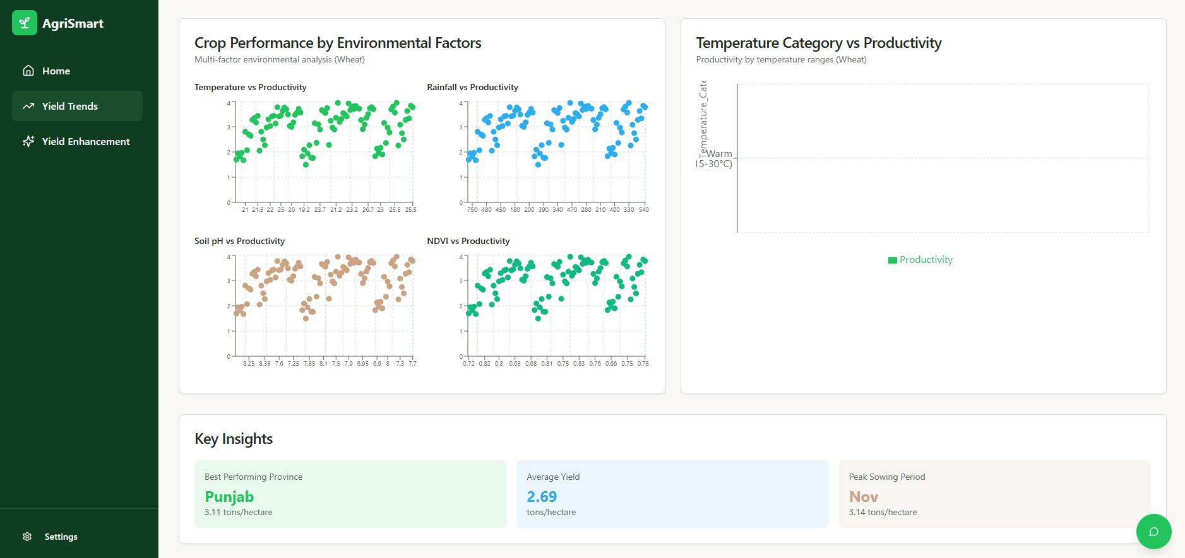
UI SCREENS
Yield Trends Page

Slide 16
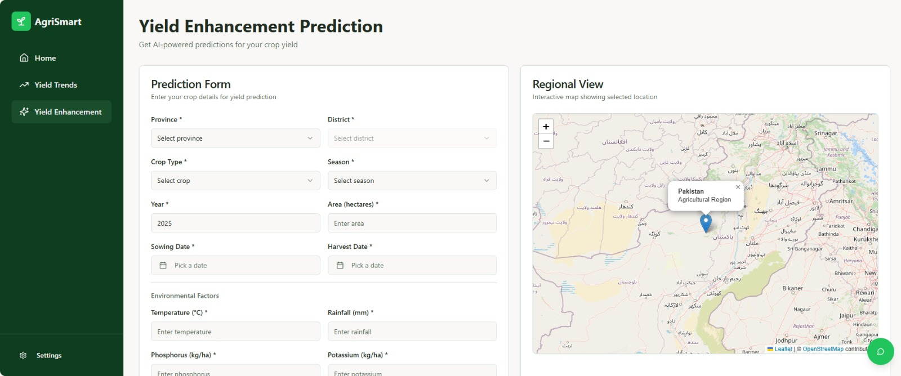
UI SCREENS
Yield Enhancement Page

Slide 17
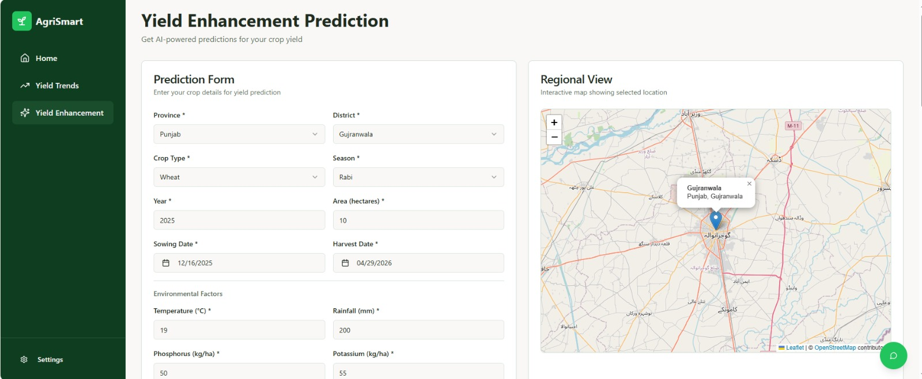
UI SCREENS
Yield Enhancement Page

Slide 18
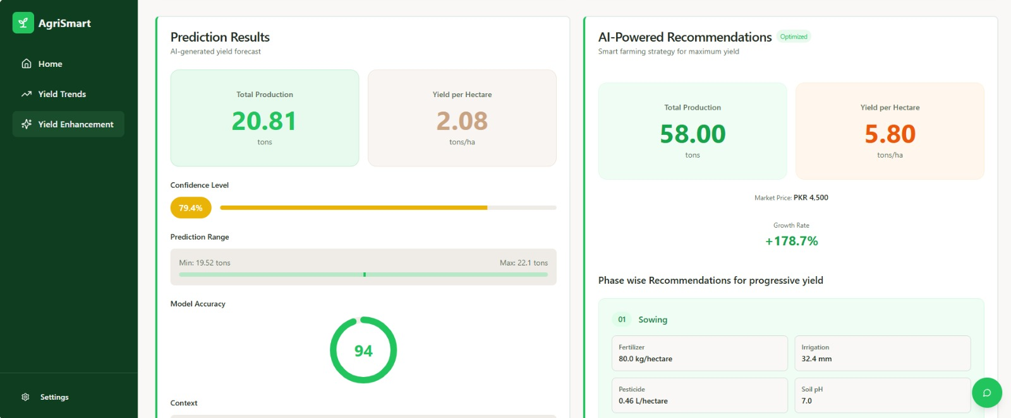
UI SCREENS
Yield Enhancement Page

Slide 19
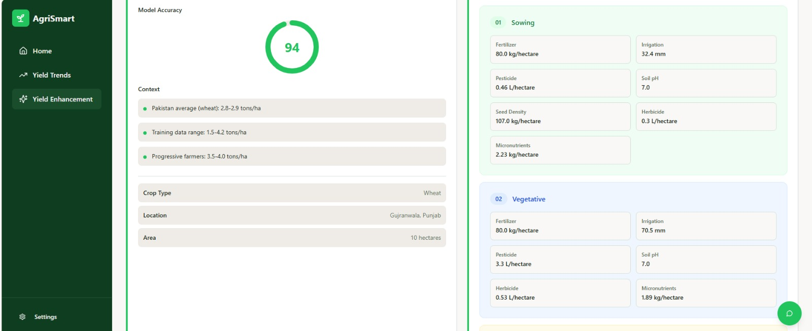
UI SCREENS
Yield Enhancement Page

Slide 20
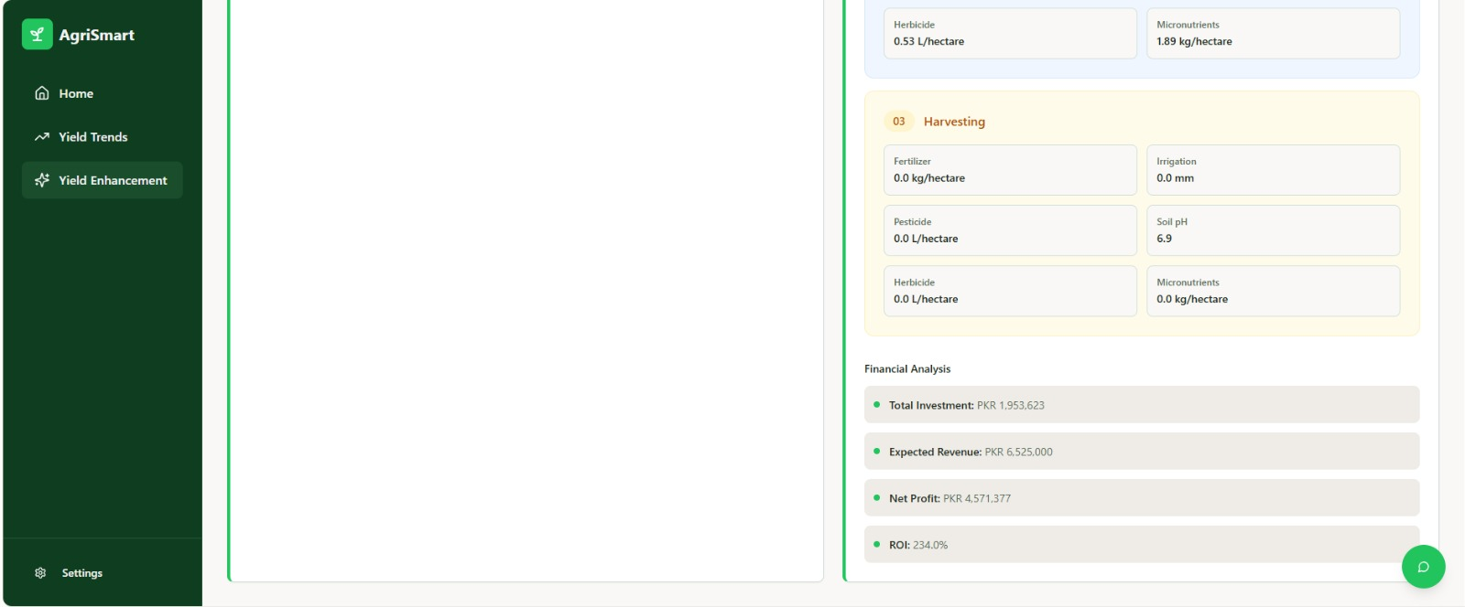
UI SCREENS
Yield Enhancement Page

Slide 21
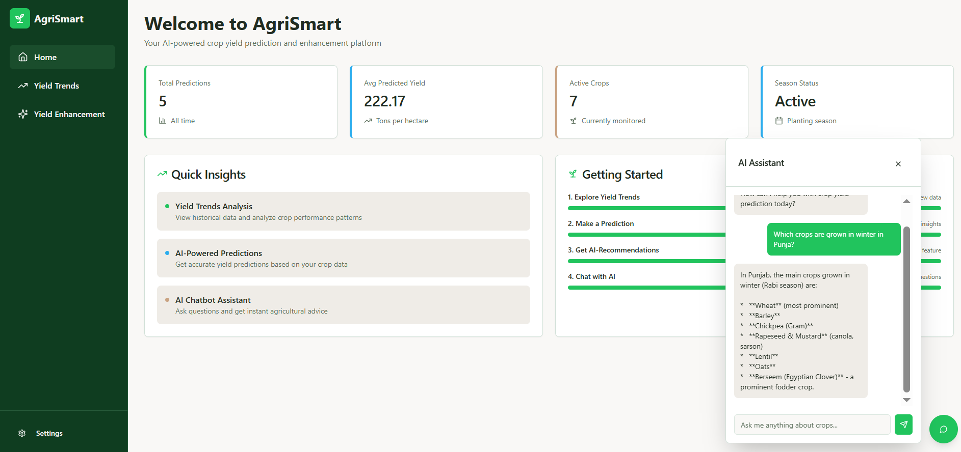
UI SCREENS
Chatbot

Slide 22
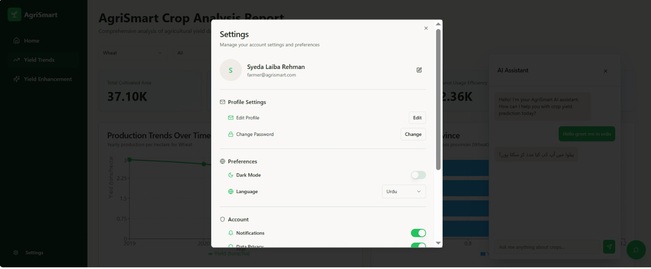
UI SCREENS
Settings Panel

Slide 23
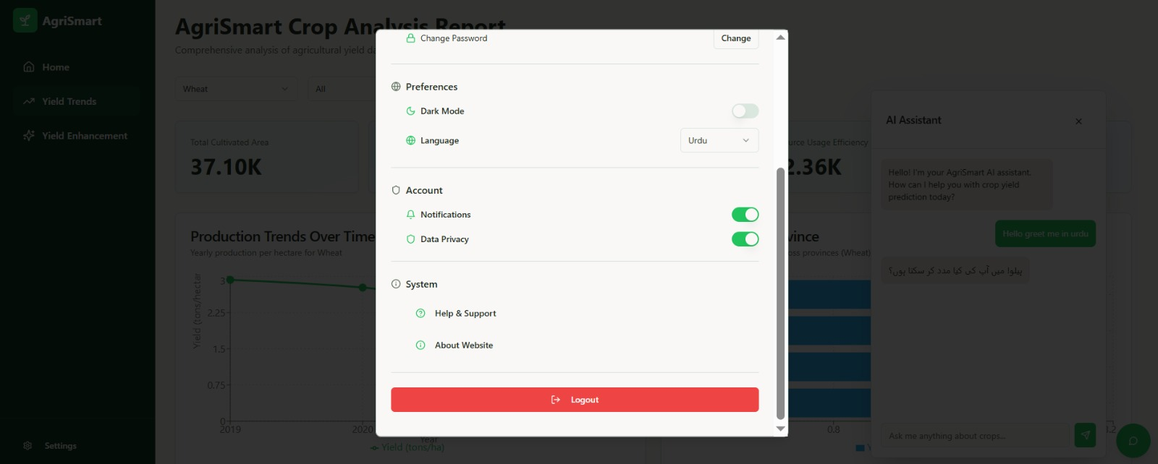
UI SCREENS
Settings Panel

Slide 24
REFERENCES
[1] Cai, Y., Guan, K., Peng, J., Wang, S., Seifert, C., Wardlow, B., & Li, Z. (2019). A high-performance and in-season classification system of field-level crop types using time-series Landsat data and a machine learning approach. Remote Sensing of Environment, 210, 35-47. https://doi.org/10.1016/j.rse.2018.02.045
[2] Chen, Y., Zhang, Z., & Tao, F. (2018). Improving regional winter wheat yield estimation through assimilation of phenology and leaf area index from remote sensing data. European Journal of Agronomy, 101, 163-173. https://doi.org/10.1016/j.eja.2018.09.006
[3] Chlingaryan, A., Sukkarieh, S., & Whelan, B. (2018). Machine learning approaches for crop yield prediction and nitrogen status estimation in precision agriculture: A review. Computers and Electronics in Agriculture, 151, 61-69. https://doi.org/10.1016/j.compag.2018.05.012
[4] Crane-Droesch, A. (2018). Machine learning methods for crop yield prediction and climate change impact assessment in agriculture. Environmental Research Letters, 13(11), 114003. https://doi.org/10.1088/1748-9326/aae159
[5] Drummond, S. T., Sudduth, K. A., Joshi, A., Birrell, S. J., & Kitchen, N. R. (2003). Statistical and neural methods for estimating soil moisture using remote sensing data. Transactions of the ASAE, 46(1), 33-41. https://doi.org/10.13031/2013.12541
[6] Everingham, Y., Sexton, J., Skocaj, D., & Inman-Bamber, G. (2016). Accurate prediction of sugarcane yield using a random forest algorithm. Agronomy for Sustainable Development, 36(2), 1-9. https://doi.org/10.1007/s13593-016-0364-z

Slide 25
REFERENCES
[7] Food and Agriculture Organization of the United Nations. (2021). World food and agriculture – Statistical yearbook 2021. FAO. https://doi.org/10.4060/cb4477en
[8] Haider, S. A., Naqvi, S. R., Akram, T., Umar, G. A., Shahzad, A., Sial, M. R., Khaliq, S., & Kamran, M. (2019). LSTM neural network based forecasting model for wheat production in Pakistan. Agronomy, 9(2), 72. https://doi.org/10.3390/agronomy9020072
[9] Hunt, E. R., Cavigelli, M., Daughtry, C. S., Mcmurtrey, J. E., & Walthall, C. L. (2005). Evaluation of digital photography from model aircraft for remote sensing of crop biomass and nitrogen status. Precision Agriculture, 6(4), 359-378. https://doi.org/10.1007/s11119-005-2324-5
[10] Hunt, E. R., Horneck, D. A., Spinelli, C. B., Turner, R. W., Bruce, A. E., Gadler, D. J., Brungardt, J. J., & Hamm, P. B. (2018). Monitoring nitrogen status of potatoes using small unmanned aerial vehicles. Precision Agriculture, 19(2), 314-333. https://doi.org/10.1007/s11119-017-9518-5
[11] Jeong, J. H., Resop, J. P., Mueller, N. D., Fleisher, D. H., Yun, K., Butler, E. E., Timlin, D. J., Shim, K. M., Gerber, J. S., Reddy, V. R., & Kim, S. H. (2016). Random forests for global and regional crop yield predictions. PLoS ONE, 11(6), e0156571. https://doi.org/10.1371/journal.pone.0156571
[12] Jiang, H., Hu, H., Zhong, R., Xu, J., Xu, J., Huang, J., Wang, S., Ying, Y., & Lin, T. (2020). A deep learning approach to conflating heterogeneous geospatial data for corn yield estimation: A case study of the US Corn Belt at the county level. Global Change Biology, 26(3), 1754-1766. https://doi.org/10.1111/gcb.14885

Slide 26
[13] Kang, Y., Ozdogan, M., Zhu, X., Ye, Z., Hain, C., & Anderson, M. (2020). Comparative assessment of environmental variables and machine learning algorithms for maize yield prediction in the US Midwest. Environmental Research Letters, 15(6), 064005. https://doi.org/10.1088/1748-9326/ab7df9
[14] Khaki, S., & Wang, L. (2019). Crop yield prediction using deep neural networks. Frontiers in Plant Science, 10, 621. https://doi.org/10.3389/fpls.2019.00621
[15] Khaki, S., Wang, L., & Archontoulis, S. V. (2020). A CNN-RNN framework for crop yield prediction. Frontiers in Plant Science, 10, 1750. https://doi.org/10.3389/fpls.2019.01750
[16] Kross, A., McNairn, H., Lapen, D., Sunohara, M., & Champagne, C. (2015). Assessment of RapidEye vegetation indices for estimation of leaf area index and biomass in corn and soybean crops. International Journal of Applied Earth Observation and Geoinformation, 34, 235-248. https://doi.org/10.1016/j.jag.2014.08.002
[17] Kuwata, K., & Shibasaki, R. (2015). Estimating crop yields with deep learning and remotely sensed data. In 2015 IEEE International Geoscience and Remote Sensing Symposium (IGARSS) (pp. 858-861). IEEE. https://doi.org/10.1109/IGARSS.2015.7325900
[18] Ministry of National Food Security & Research, Government of Pakistan. (2020). Agricultural statistics of Pakistan 2018-19. Pakistan Bureau of Statistics.

Slide 27
THANK YOU

